Slide 1
SÛR MILE
Passenger - Bus company - Database

Slide 2
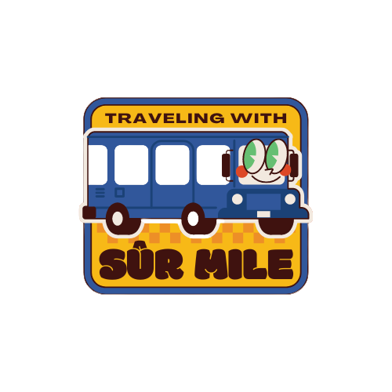
Introduction
Sûr Mile is a travel companion designed to make travelling safer.

Slide 3

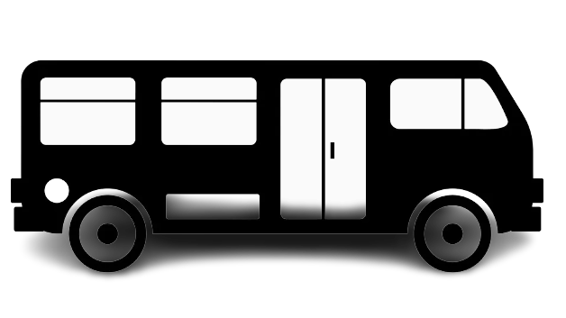
ADB Challenge
Transport Technology Innovation Challenge
Improve Security For Public Transport Users

Slide 4
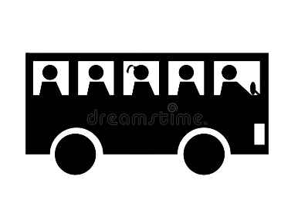

Userbase For The System
Bus Owner’s
Bus Passengers

Slide 5
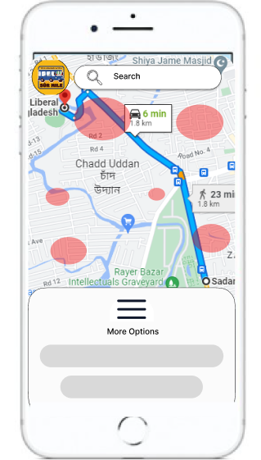
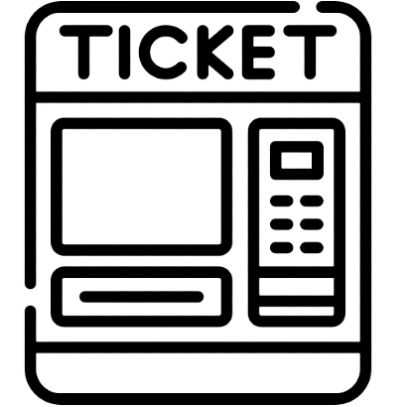
Snapshot of the database

Slide 6
Features
Bus Owner’s
Overcrowding data collection
Emergency location sharing
App User’s
Emergency news
Location of nearest police station/hospitals/etc.
Sharing your location with another user
Crowd sourced crime data update

Slide 7
What are the benefits?

Slide 8



Crime Data Update
Users will be able to report crime in an area
Passengers can be ensured to be safe at their end mile
Inspired by Safe City Initiative

Slide 9


Emergency News Update
Will get notified about bad weather conditions or any natural disaster in the area
Will get notified about any ongoing or potentially political condition in the area

Slide 10
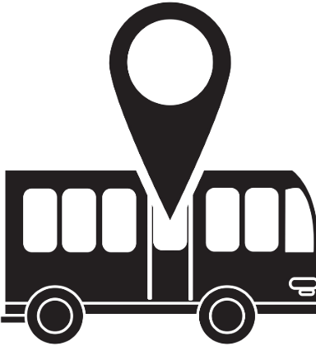

Real Time Location
Show real time location of the user to another user
Show real time location of the bus for passengers

Slide 11
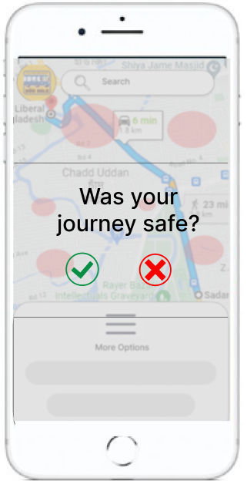
Overcrowding Data Collection
Use of the ticket machine can allow us to collet data about overcrowding which is a security issue.
Collection of data is the first step to analyze the problem and make sensible solutions

Slide 12
Thank you Any Questions?

